Slide 1
Drug Recommendation System
Sadasivam ‘Shiv’ Natanakumar
Nidhi Mankala
Sri Harshan Ganugula

Slide 2
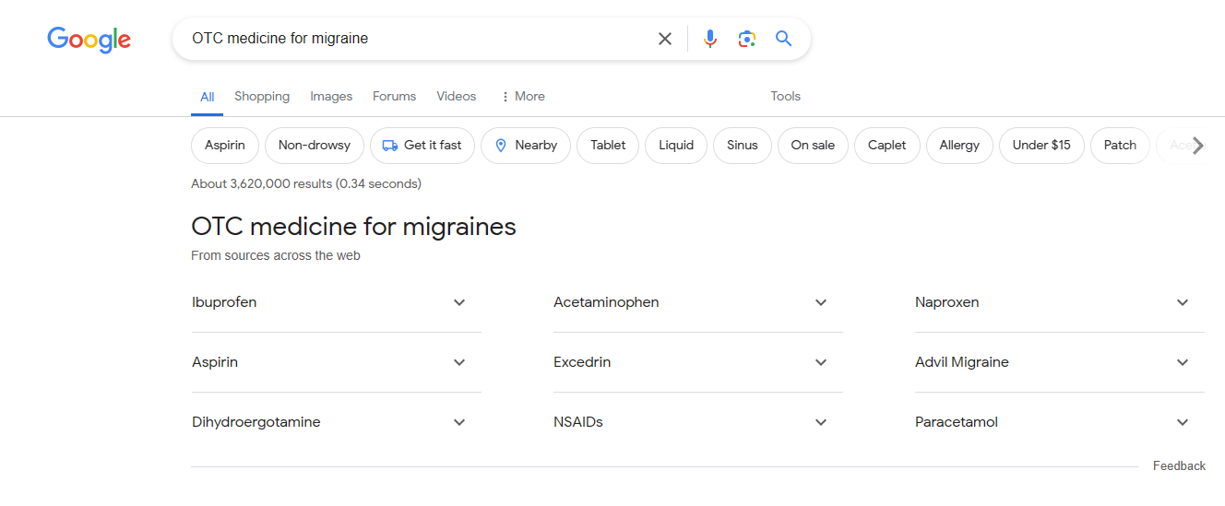
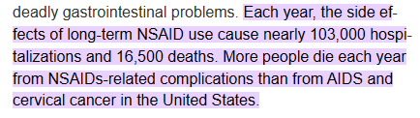
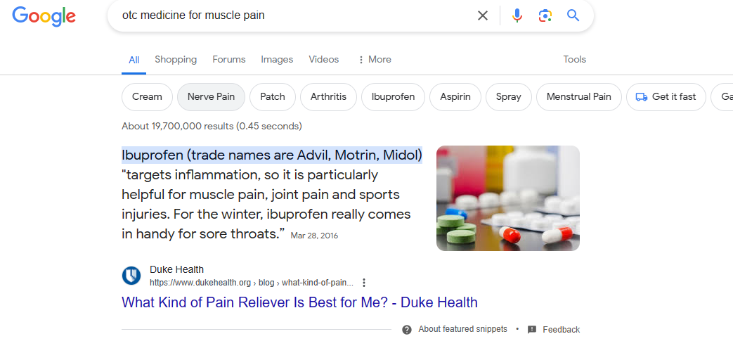
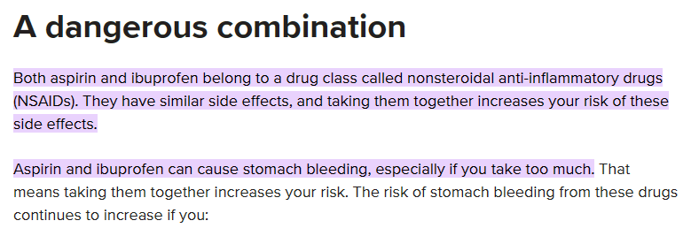
Problem Statement (Background Context)

Slide 3
Problem Statement (Why, Issues & Solutions)
Why is this interesting/challenging?
  Everyone wants to get a quick solution for an Over-the-counter medication
  Due to lack of public data, similar projects have failed or eventually gone behind paywalls
Issues
  Google search has lost clarity over time
  Sources from across the web, may not always be accurate
  Does not mention drugs that affect the medicine adversely
  Can’t always trust ratings, need to look at reviews + other metrics
Solutions
  Create a combined dataset of above metrics + DrugBank data to identify common drug names and their negative interaction with other drugs
  Create a RecSys that can be leveraged by general public for simple medication and professionals for higher degree issues
  Manipulating the data to work as user-item profiles to apply filtering techniques

Slide 4
Data Sources
Various Drug and Disease datasets from Stanford’s BioSNAP (Stanford Biomedical Network Dataset Collection) that have over 5.5 million samples on Drug-Drug relation.
DrugBank dataset (DrugBank Release Version 5.1.12 | DrugBank Online) to merge Drug ID and Names and Synonyms
UCI Drug Review dataset (https://doi.org/10.24432/C55G6J) to harvest ratings and useful counts.
Final dataset resulted in over 23,000 drug-condition-review combinations that were analyzed for the Recommender System

Slide 5
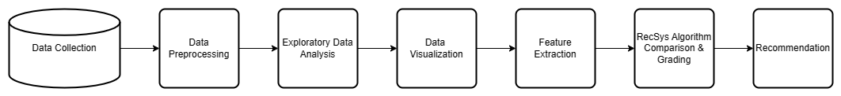
Methodology

Slide 6
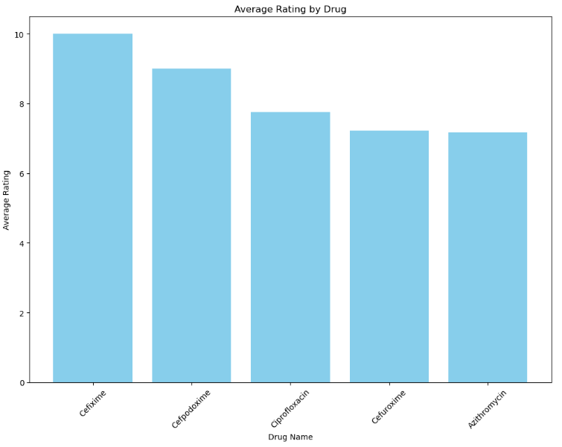
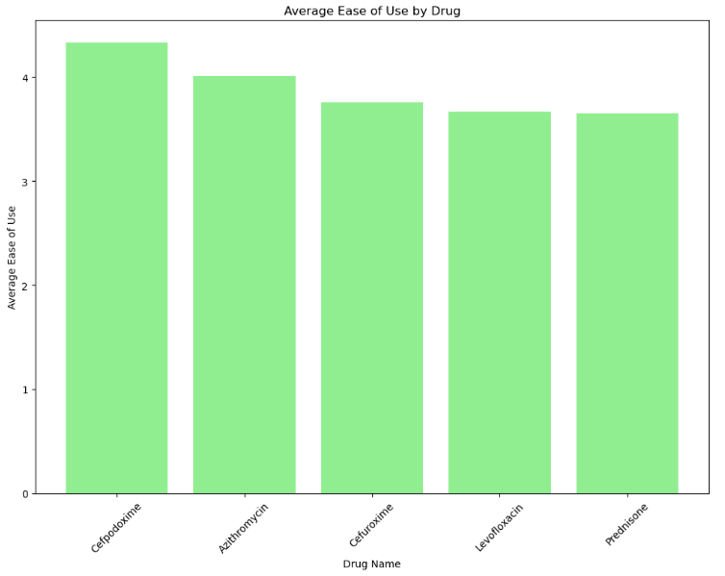
EDA

Slide 7
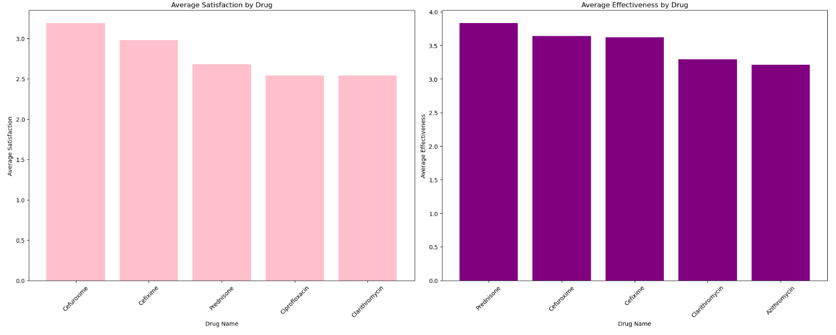
EDA (cont.)

Slide 8
ALS Recommendations
Treated Condition as rows and Drugs as Columns
Utilized Weighted Average of Ratings: Adjusted for variable review counts to enhance data reliability, giving more weight to ratings from larger sample sizes.
Leveraged Alternating Least Squares to derive high-quality embeddings of drugs and conditions, enabling sophisticated patterns and improved recommendation.

Slide 9
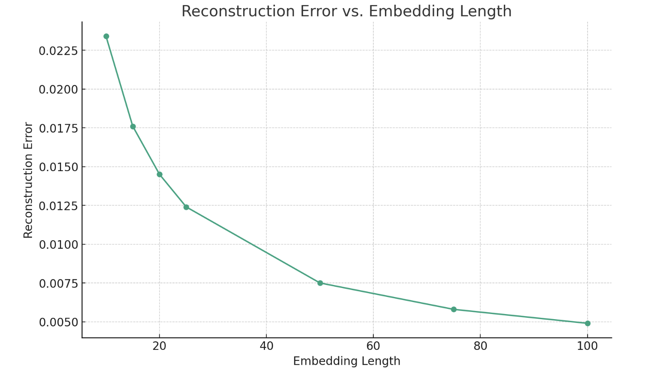

Slide 10
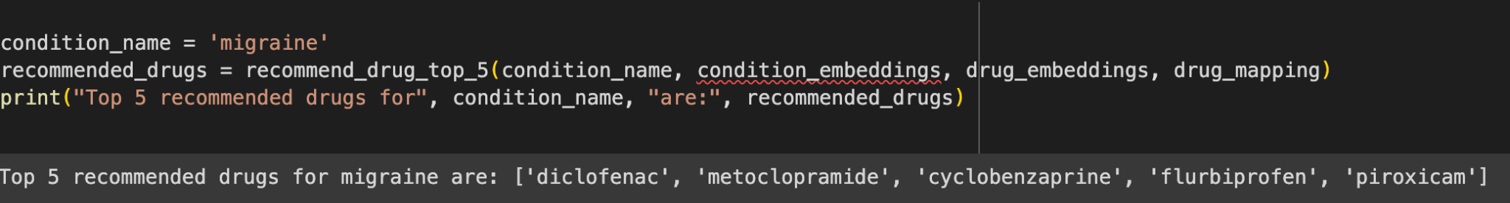
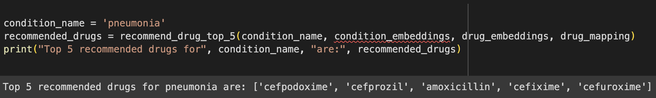
ALS Results

Slide 11
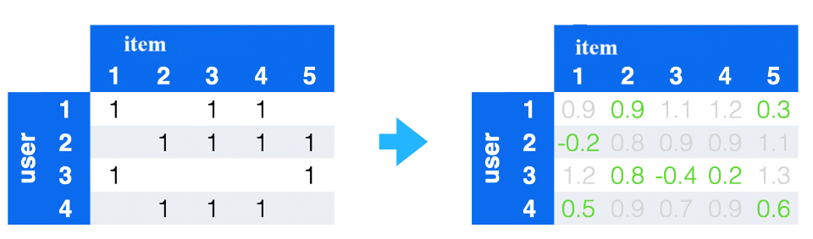
RecSys using Autoencoders (Neural Network)
Why use Autoencoders in RecSys?
These are Neural Network used specifically for Unsupervised learning
Reduces dimensionality while capturing underlying features {eg: 3412 columns(items) in our project}
Capture missing user-item interactions
Notes:
Autoencoders are often deployed in Recommender Systems due to their ability compress high-dimensional data into a lower-dimensional latent space while preserving important features and underlying features.

Slide 12
Model Architecture
Our model has 7 layers:
Input layer: Represents user-item interaction data.
Encoder layers: Reduce the dimensionality of the input data.
Latent space: Represents the compressed representation of users and items.
2 Decoder layers: Reconstruct the original input data from the latent space.
Output layer: Represents the reconstructed user-item interaction data.
With a learning rate of 0.001 and Relu activation function

Slide 13
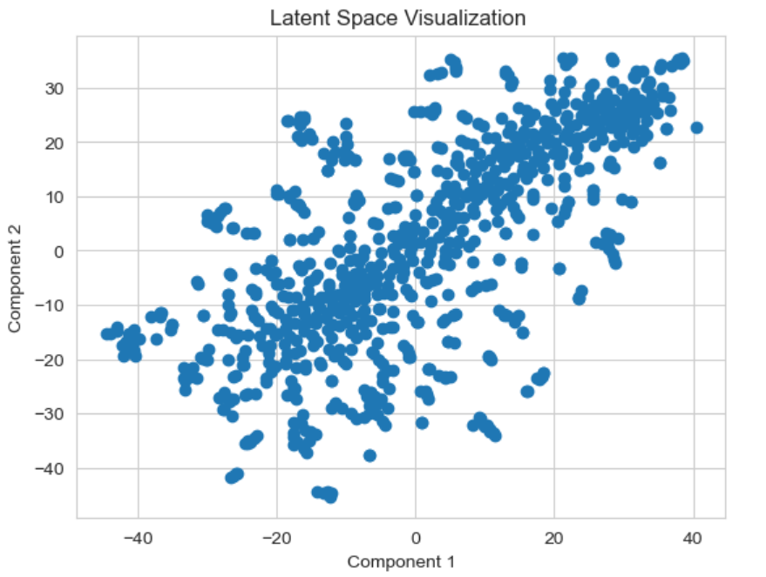
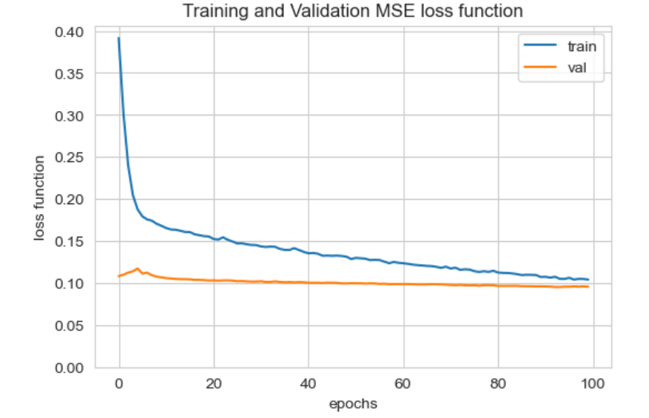
Model Plots
latent space is a low-dimensional representation of the input data that is learned by the model
Used t-SNE for this viz.
Few distinct clusters noticed
This plot shows the training and validation mean square error for 100 iterations.
The average MSE is 0.184

Slide 14
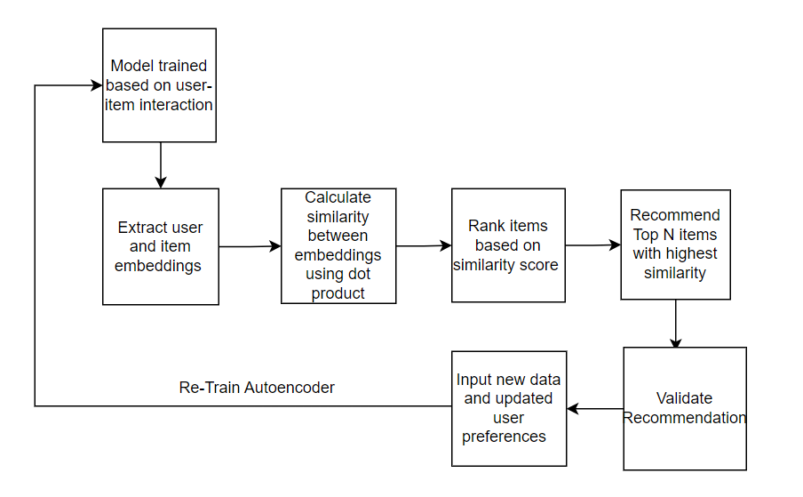
How does an Autoencoder generate Recommendation ?

Slide 15
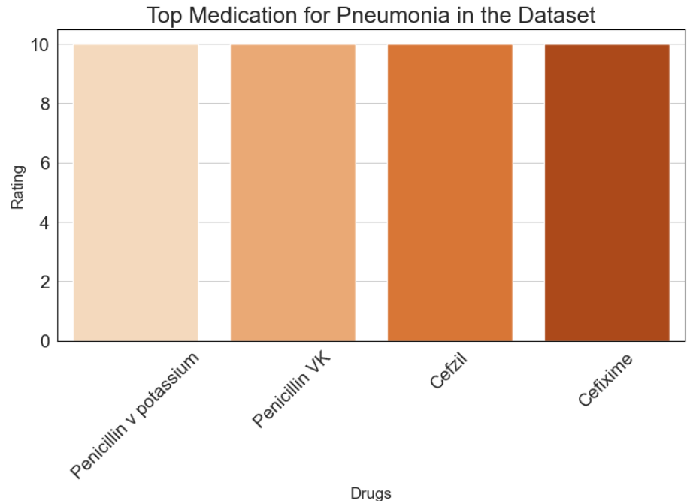
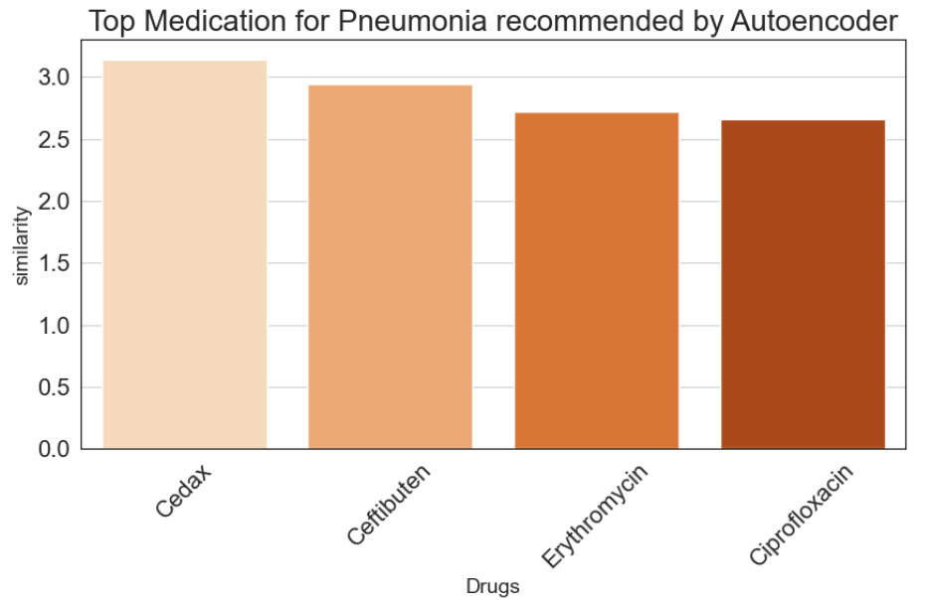
Results: Recommending drugs for Pneumonia
Plot 1
Plot 2

Slide 16
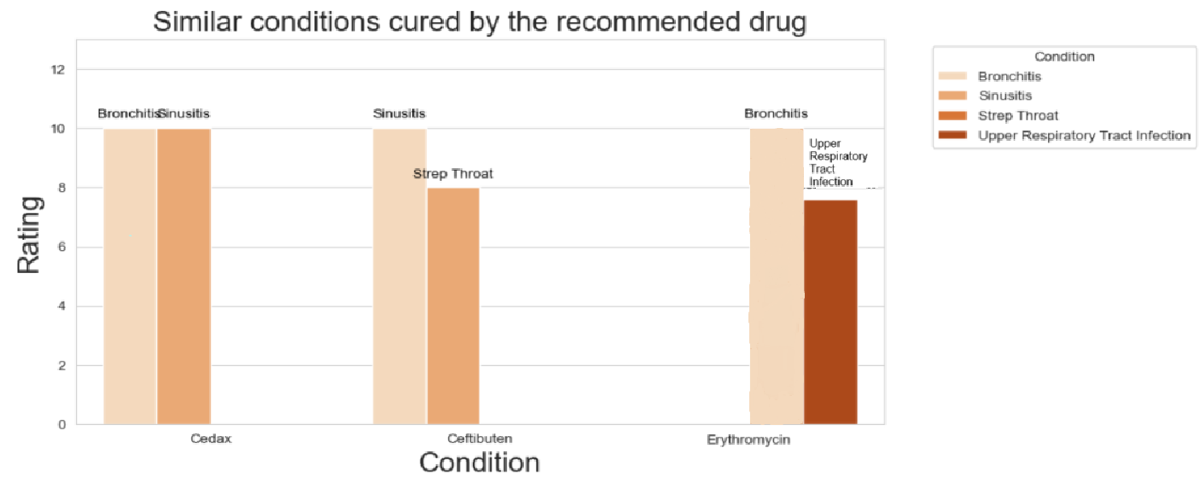
Results: Recommending drugs for Pneumonia

Slide 17
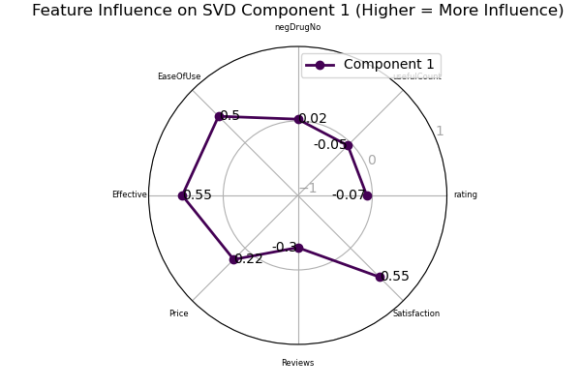
Collaborative Filtering using SVD (How?)
Treating the conditions as users
and drugs as items by vectorizing
Creating user and item matrices
by pivoting the aggregated data
Performing SVD to make
predictions on each drug for the
relevant conditions based on
the components that capture at
least ~95% of the data variance

Slide 18
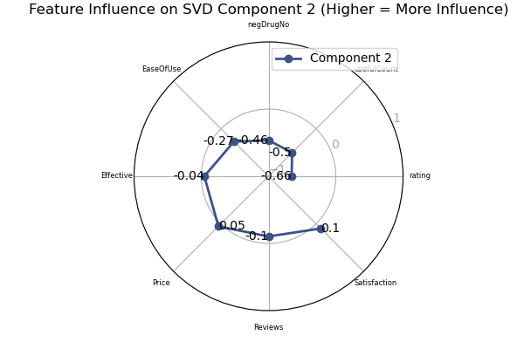
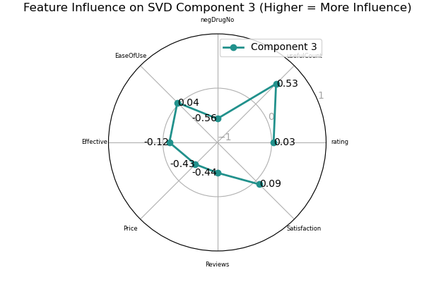
SVD (Feature Importance)

Slide 19
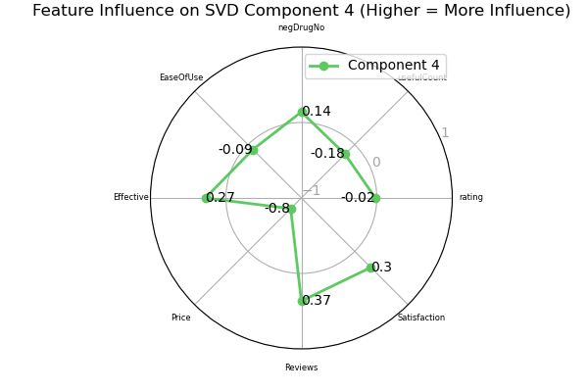
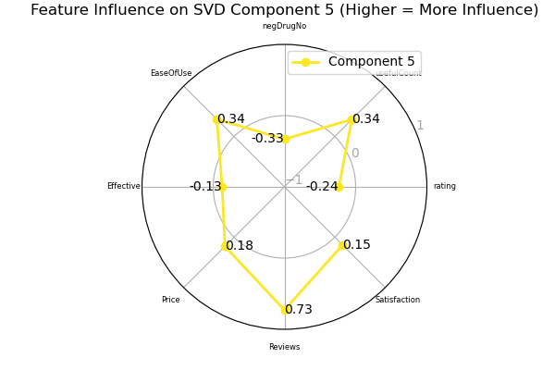
SVD (Feature Importance)

Slide 20
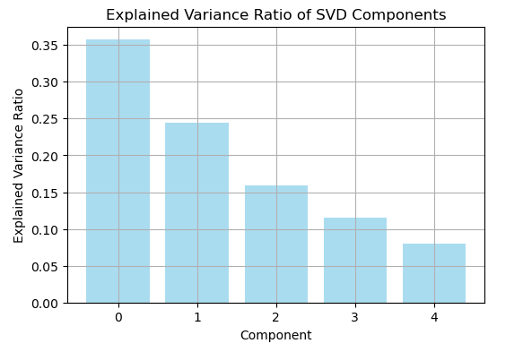
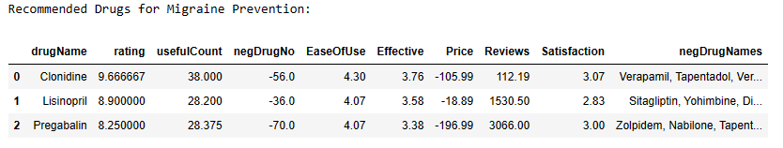
SVD (Results)
Using 5 components to
capture 95% of the variance
Gives a direct solution to your
condition, with mention of
all the missing metrics from
today’s search engines.
Mentions drugs that negatively
affect the recommended drug
so user can avoid harmful
effects.

Slide 21
Thank You!

